Slide 1
FAKULTAS TEKNOLOGI INFORMASI
PENAMBANGAN DATA
[ KP368 / 3 SKS ]

Slide 2
DATA DAN DATA PRE-PROCESSING
Pertemuan 3

Slide 3
Tujuan Pembelajaran
Mahasiswa mampu memahami berbagai bentuk data dan proses mempersiapkan data (data preprocessing)

Slide 4
Topik Pembahasan
3.1 Data
3.2 Data Preprocessing
3.3 Data Cleaning
3.4 Data Reduction
3.5 Data Transformation and Data Discretization
3.6 Data Integration

Slide 5
What is Data?
Attributes
Collection of data objects and their attributes
An attribute is a property or characteristic of an object
Examples: eye color of a person, temperature, etc.
Attribute is also known as variable, field, characteristic, dimension, or feature
A collection of attributes describe an object
Object is also known as record, point, case, sample, entity, or instance
Objects

Slide 6
A More Complete View of Data
Data may have parts
The different parts of the data may have relationships
More generally, data may have structure
Data can be incomplete
We will discuss this in more detail later

Slide 7
Attribute Values
Attribute values are numbers or symbols assigned to an attribute for a particular object
Distinction between attributes and attribute values
Same attribute can be mapped to different attribute values
Example: height can be measured in feet or meters
Different attributes can be mapped to the same set of values
Example: Attribute values for ID and age are integers
But properties of attribute values can be different

Slide 8
Measurement of Length
The way you measure an attribute may not match the attributes properties.
This scale preserves only the ordering property of length.
This scale preserves the ordering and additvity properties of length.

Slide 9
Types of Attributes
There are different types of attributes
Nominal
Examples: ID numbers, eye color, zip codes
Ordinal
Examples: rankings (e.g., taste of potato chips on a scale from 1-10), grades, height {tall, medium, short}
Interval
Examples: calendar dates, temperatures in Celsius or Fahrenheit.
Ratio
Examples: temperature in Kelvin, length, time, counts

Slide 10
Properties of Attribute Values
The type of an attribute depends on which of the following properties/operations it possesses:
Distinctness: = ≠
Order: < >
Differences are + - meaningful :
Ratios are * / meaningful
Nominal attribute: distinctness
Ordinal attribute: distinctness & order
Interval attribute: distinctness, order & meaningful differences
Ratio attribute: all 4 properties/operations

Slide 11
Difference Between Ratio and Interval
Is it physically meaningful to say that a temperature of 10 ° is twice that of 5° on
the Celsius scale?
the Fahrenheit scale?
the Kelvin scale?
Consider measuring the height above average
If Bill’s height is three inches above average and Bob’s height is six inches above average, then would we say that Bob is twice as tall as Bill?
Is this situation analogous to that of temperature?

Slide 12
This categorization of attributes is due to S. S. Stevens

Slide 13
This categorization of attributes is due to S. S. Stevens

Slide 14
Discrete and Continuous Attributes
Discrete Attribute
Has only a finite or countably infinite set of values
Examples: zip codes, counts, or the set of words in a collection of documents
Often represented as integer variables.
Note: binary attributes are a special case of discrete attributes
Continuous Attribute
Has real numbers as attribute values
Examples: temperature, height, or weight.
Practically, real values can only be measured and represented using a finite number of digits.
Continuous attributes are typically represented as floating-point variables.

Slide 15
Asymmetric Attributes
Only presence (a non-zero attribute value) is regarded as important
Words present in documents
Items present in customer transactions
If we met a friend in the grocery store would we ever say the following? “I see our purchases are very similar since we didn’t buy most of the same things.”
We need two asymmetric binary attributes to represent one ordinary binary attribute
Association analysis uses asymmetric attributes
Asymmetric attributes typically arise from objects that are sets

Slide 16
Some Extensions and Critiques
Velleman, Paul F., and Leland Wilkinson. "Nominal, ordinal, interval, and ratio typologies are misleading." The American Statistician 47, no. 1 (1993): 65-72.
Mosteller, Frederick, and John W. Tukey. "Data analysis and regression. A second course in statistics." Addison-Wesley Series in Behavioral Science: Quantitative Methods, Reading, Mass.: Addison-Wesley, 1977.
Chrisman, Nicholas R. "Rethinking levels of measurement for cartography."Cartography and Geographic Information Systems 25, no. 4 (1998): 231-242.

Slide 17
Critiques
Incomplete
Asymmetric binary
Cyclical
Multivariate
Partially ordered
Partial membership
Relationships between the data
Real data is approximate and noisy
This can complicate recognition of the proper attribute type
Treating one attribute type as another may be approximately correct

Slide 18
Critiques …
Not a good guide for statistical analysis
May unnecessarily restrict operations and results
Statistical analysis is often approximate
Thus, for example, using interval analysis for ordinal values may be justified
Transformations are common but don’t preserve scales
Can transform data to a new scale with better statistical properties
Many statistical analyses depend only on the distribution

Slide 19
More Complicated Examples
ID numbers
Nominal, ordinal, or interval?
Number of cylinders in an automobile engine
Nominal, ordinal, or ratio?
Biased Scale
Interval or Ratio

Slide 20
Key Messages for Attribute Types
The types of operations you choose should be “meaningful” for the type of data you have
Distinctness, order, meaningful intervals, and meaningful ratios are only four properties of data
The data type you see – often numbers or strings – may not capture all the properties or may suggest properties that are not there
Analysis may depend on these other properties of the data
Many statistical analyses depend only on the distribution
Many times what is meaningful is measured by statistical significance
But in the end, what is meaningful is measured by the domain

Slide 21
Types of data sets
Record
Data Matrix
Document Data
Transaction Data
Graph
World Wide Web
Molecular Structures
Ordered
Spatial Data
Temporal Data
Sequential Data
Genetic Sequence Data

Slide 22
Important Characteristics of Data
Dimensionality (number of attributes)
High dimensional data brings a number of challenges
Sparsity
Only presence counts
Resolution
Patterns depend on the scale
Size
Type of analysis may depend on size of data

Slide 23
Record Data
Data that consists of a collection of records, each of which consists of a fixed set of attributes

Slide 24
Data Matrix
If data objects have the same fixed set of numeric attributes, then the data objects can be thought of as points in a multi-dimensional space, where each dimension represents a distinct attribute
Such data set can be represented by an m by n matrix, where there are m rows, one for each object, and n columns, one for each attribute

Slide 25
Document Data
Each document becomes a ‘term’ vector
Each term is a component (attribute) of the vector
The value of each component is the number of times the corresponding term occurs in the document.

Slide 26
Transaction Data
A special type of record data, where
Each record (transaction) involves a set of items.
For example, consider a grocery store. The set of products purchased by a customer during one shopping trip constitute a transaction, while the individual products that were purchased are the items.

Slide 27
Graph Data
Examples: Generic graph, a molecule, and webpages
Benzene Molecule: C6H6

Slide 28
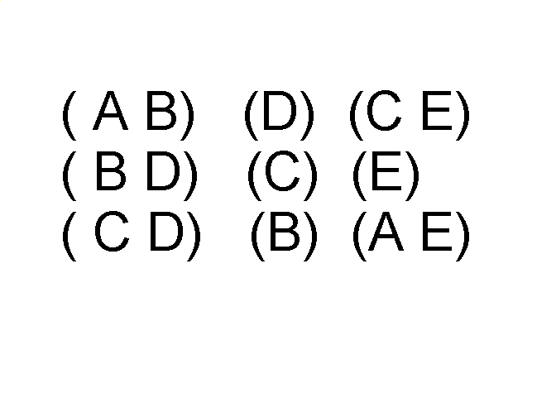
Ordered Data
Sequences of transactions
Items/Events
An element of the sequence

Slide 29
Ordered Data
Genomic sequence data

Slide 30
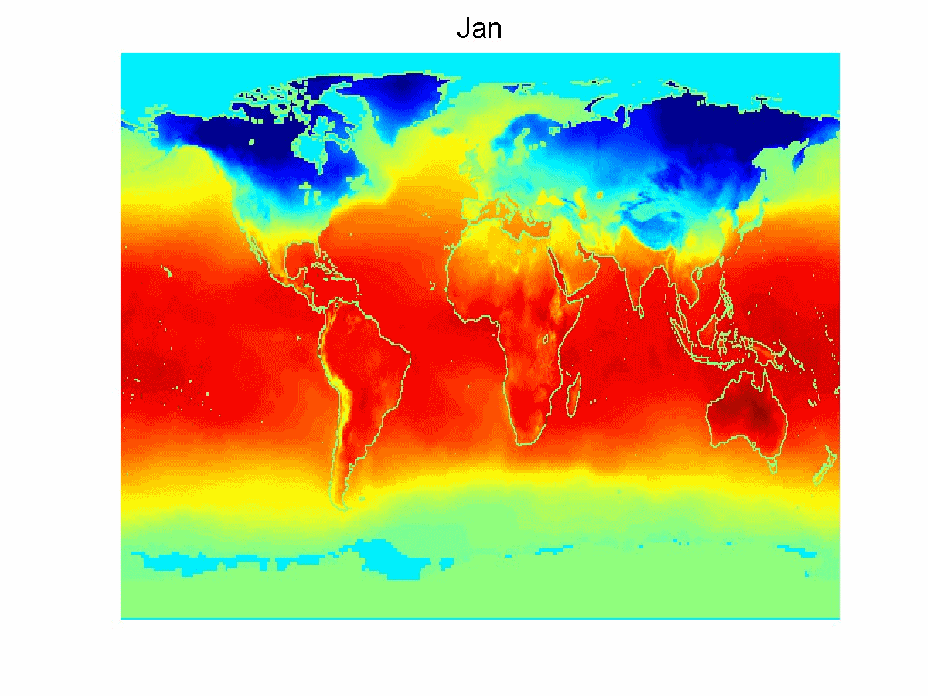
Ordered Data
Spatio-Temporal Data
Average Monthly Temperature of land and ocean

Slide 31
Data Quality
Poor data quality negatively affects many data processing efforts
“The most important point is that poor data quality is an unfolding disaster.
Poor data quality costs the typical company at least ten percent (10%) of revenue; twenty percent (20%) is probably a better estimate.”
Thomas C. Redman, DM Review, August 2004
Data mining example: a classification model for detecting people who are loan risks is built using poor data
Some credit-worthy candidates are denied loans
More loans are given to individuals that default

Slide 32
Data Quality …
What kinds of data quality problems?
How can we detect problems with the data?
What can we do about these problems?
Examples of data quality problems:
Noise and outliers
Missing values
Duplicate data
Wrong data

Slide 33
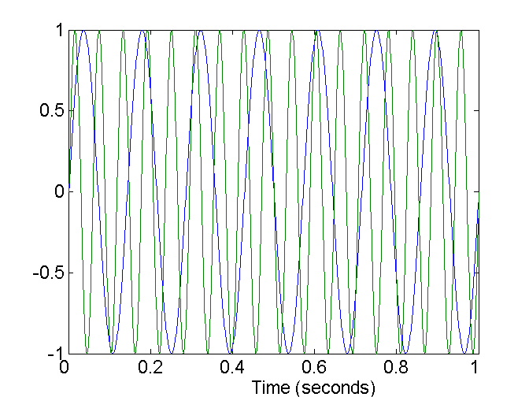
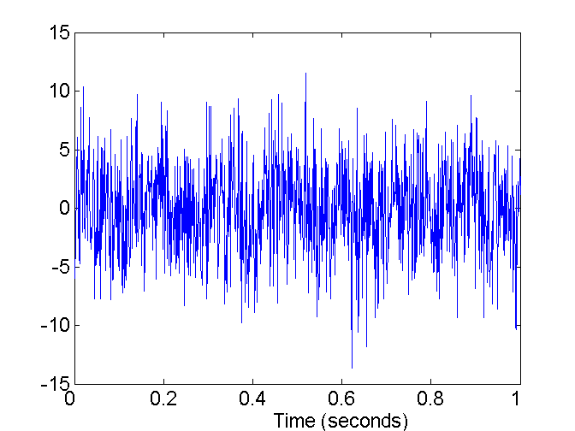
Noise
For objects, noise is an extraneous object
For attributes, noise refers to modification of original values
Examples: distortion of a person’s voice when talking on a poor phone and “snow” on television screen
Two Sine Waves
Two Sine Waves + Noise

Slide 34

Outliers
Outliers are data objects with characteristics that are considerably different than most of the other data objects in the data set
Case 1: Outliers are noise that interferes with data analysis
Case 2: Outliers are the goal of our analysis
Credit card fraud
Intrusion detection
Causes?

Slide 35
Missing Values
Reasons for missing values
Information is not collected (e.g., people decline to give their age and weight)
Attributes may not be applicable to all cases (e.g., annual income is not applicable to children)
Handling missing values
Eliminate data objects or variables
Estimate missing values
Example: time series of temperature
Example: census results
Ignore the missing value during analysis

Slide 36
Missing Values …
Missing completely at random (MCAR)
Missingness of a value is independent of attributes
Fill in values based on the attribute
Analysis may be unbiased overall
Missing at Random (MAR)
Missingness is related to other variables
Fill in values based other values
Almost always produces a bias in the analysis
Missing Not at Random (MNAR)
Missingness is related to unobserved measurements
Informative or non-ignorable missingness
Not possible to know the situation from the data

Slide 37
Duplicate Data
Data set may include data objects that are duplicates, or almost duplicates of one another
Major issue when merging data from heterogeneous sources
Examples:
Same person with multiple email addresses
Data cleaning
Process of dealing with duplicate data issues
When should duplicate data not be removed?

Slide 38
3.2 Data Preprocessing

Slide 39
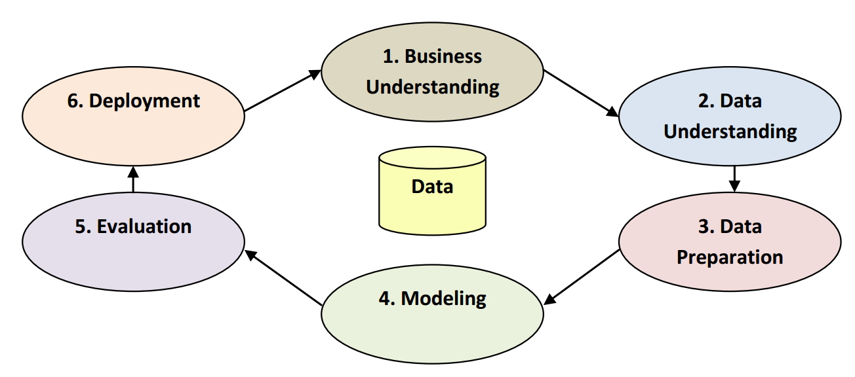
CRISP-DM

Slide 40
Why Preprocess the Data?
Measures for data quality: A multidimensional view
Accuracy: correct or wrong, accurate or not
Completeness: not recorded, unavailable, …
Consistency: some modified but some not, …
Timeliness: timely update?
Believability: how trustable the data are correct?
Interpretability: how easily the data can be understood?

Slide 41
Major Tasks in Data Preprocessing
Data cleaning
Fill in missing values
Smooth noisy data
Identify or remove outliers
Resolve inconsistencies
Data reduction
Dimensionality reduction
Numerosity reduction
Data compression
Data transformation and data discretization
Normalization
Concept hierarchy generation
Data integration
Integration of multiple databases or files

Slide 42
3.3 Data Cleaning

Slide 43
Data Cleaning
Data in the Real World Is Dirty: Lots of potentially incorrect data, e.g., instrument faulty, human or computer error, transmission error
Incomplete: lacking attribute values, lacking certain attributes of interest, or containing only aggregate data
e.g., Occupation=“ ” (missing data)
Noisy: containing noise, errors, or outliers
e.g., Salary=“−10” (an error)
Inconsistent: containing discrepancies in codes or names
e.g., Age=“42”, Birthday=“03/07/2010”
Was rating “1, 2, 3”, now rating “A, B, C”
Discrepancy between duplicate records
Intentional (e.g., disguised missing data)
Jan. 1 as everyone’s birthday?

Slide 44
Incomplete (Missing) Data
Data is not always available
E.g., many tuples have no recorded value for several attributes, such as customer income in sales data
Missing data may be due to
equipment malfunction
inconsistent with other recorded data and thus deleted
data not entered due to misunderstanding
certain data may not be considered important at the time of entry
not register history or changes of the data
Missing data may need to be inferred

Slide 45
MissingDataSet.csv
Jerry is the marketing manager for a small Internet design and advertising firm
Jerry’s boss asks him to develop a data set containing information about Internet users
The company will use this data to determine what kinds of people are using the Internet and how the firm may be able to market their services to this group of users
To accomplish his assignment, Jerry creates an online survey and places links to the survey on several popular Web sites
Within two weeks, Jerry has collected enough data to begin analysis, but he finds that his data needs to be denormalized
He also notes that some observations in the set are missing values or they appear to contain invalid values
Jerry realizes that some additional work on the data needs to take place before analysis begins.

Slide 46
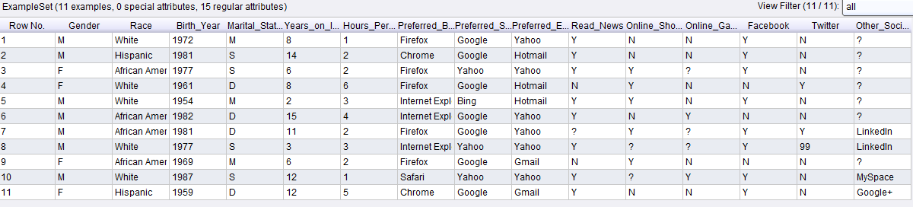
Contoh Missing Data
Dataset: MissingDataSet.csv

Slide 47
How to Handle Missing Data?
Ignore the tuple:
Usually done when class label is missing (when doing classification)—not effective when the % of missing values per attribute varies considerably
Fill in the missing value manually:
Tedious + infeasible?
Fill in it automatically with
A global constant: e.g., “unknown”, a new class?!
The attribute mean
The attribute mean for all samples belonging to the same class: smarter
The most probable value: inference-based such as Bayesian formula or decision tree

Slide 48
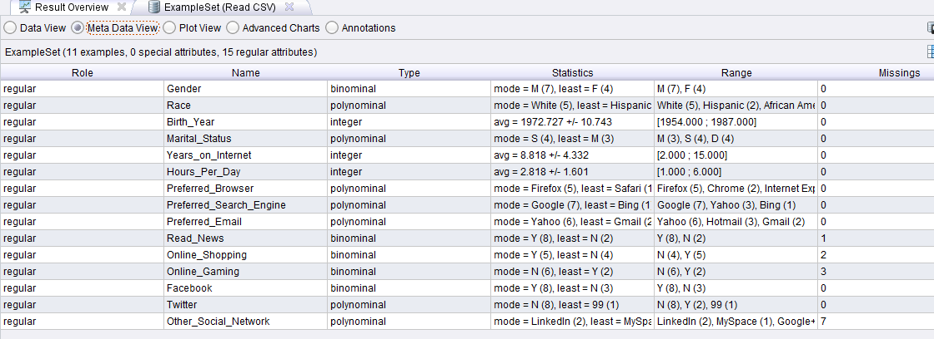
Missing Value Detection

Slide 49
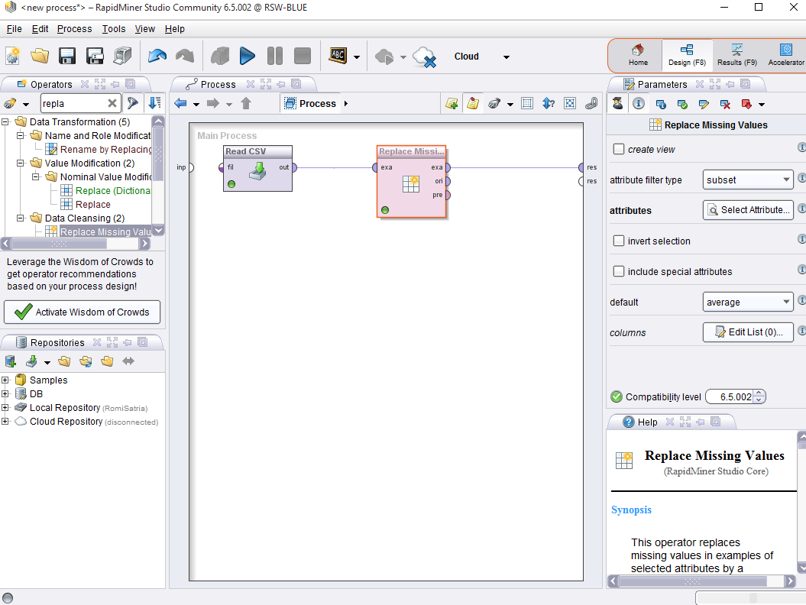

Slide 50
Noisy Data
Noise: random error or variance in a measured variable
Incorrect attribute values may be due to
Faulty data collection instruments
Data entry problems
Data transmission problems
Technology limitation
Inconsistency in naming convention
Other data problems which require data cleaning
Duplicate records
Incomplete data
Inconsistent data

Slide 51
How to Handle Noisy Data?
Binning
First sort data and partition into (equal-frequency) bins
Then one can smooth by bin means, smooth by bin median, smooth by bin boundaries, etc.
Regression
Smooth by fitting the data into regression functions
Clustering
Detect and remove outliers
Combined computer and human inspection
Detect suspicious values and check by human (e.g., deal with possible outliers)

Slide 52
Data Cleaning as a Process
Data discrepancy detection
Use metadata (e.g., domain, range, dependency, distribution)
Check field overloading
Check uniqueness rule, consecutive rule and null rule
Use commercial tools
Data scrubbing: use simple domain knowledge (e.g., postal code, spell-check) to detect errors and make corrections
Data auditing: by analyzing data to discover rules and relationship to detect violators (e.g., correlation and clustering to find outliers)
Data migration and integration
Data migration tools: allow transformations to be specified
ETL (Extraction/Transformation/Loading) tools: allow users to specify transformations through a graphical user interface
Integration of the two processes
Iterative and interactive (e.g., Potter’s Wheels)

Slide 53
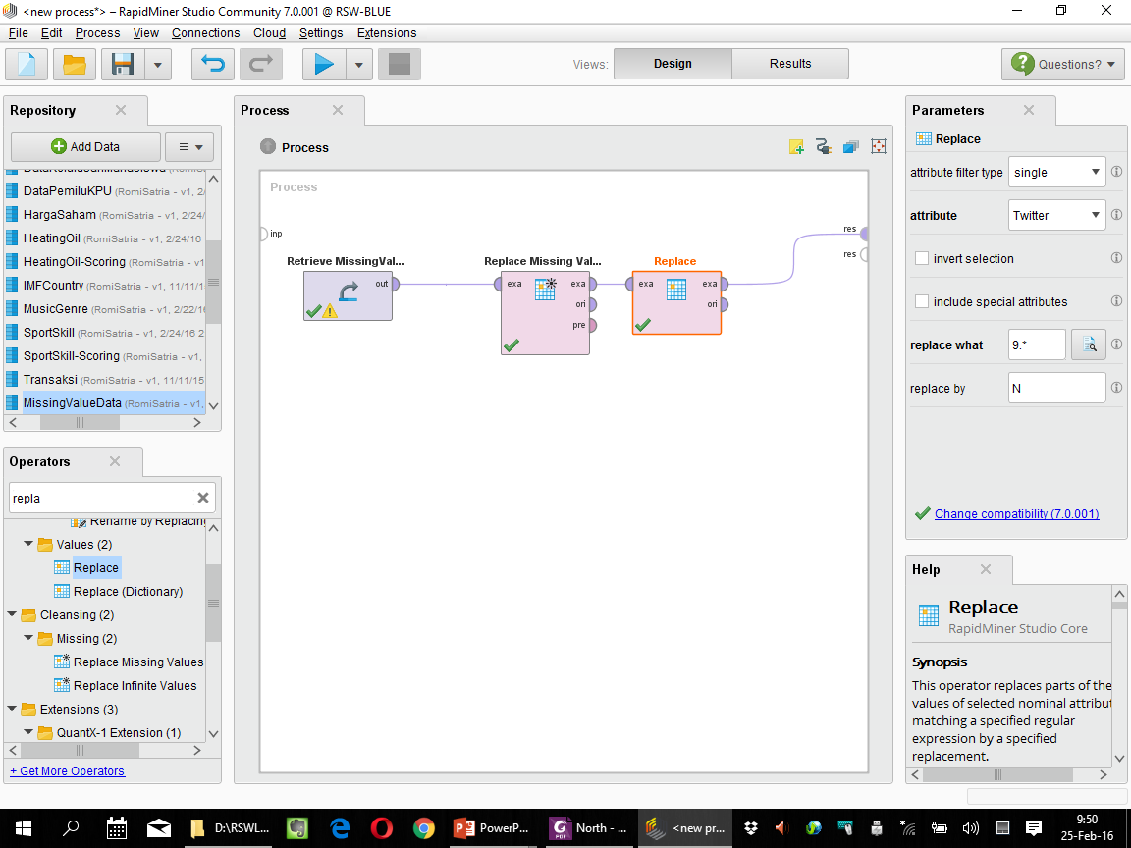

Slide 54
Kesimpulan
Data quality: accuracy, completeness, consistency, timeliness, believability, interpretability
Data cleaning: e.g. missing/noisy values, outliers

Slide 55
Referensi
Jiawei Han and Micheline Kamber, Data Mining: Concepts and Techniques Third Edition, Elsevier, 2012
Ian H. Witten, Frank Eibe, Mark A. Hall, Data mining: Practical Machine Learning Tools and Techniques 3rd Edition, Elsevier, 2011
Markus Hofmann and Ralf Klinkenberg, RapidMiner: Data Mining Use Cases and Business Analytics Applications, CRC Press Taylor & Francis Group, 2014
Daniel T. Larose, Discovering Knowledge in Data: an Introduction to Data Mining, John Wiley & Sons, 2005
Ethem Alpaydin, Introduction to Machine Learning, 3rd ed., MIT Press, 2014
Florin Gorunescu, Data Mining: Concepts, Models and Techniques, Springer, 2011
Oded Maimon and Lior Rokach, Data Mining and Knowledge Discovery Handbook Second Edition, Springer, 2010
Warren Liao and Evangelos Triantaphyllou (eds.), Recent Advances in Data Mining of Enterprise Data: Algorithms and Applications, World Scientific, 2007

Slide 56


Kesimpulan
SELESAI

